Slide 1
Hampton, Va. OPEN Secondary
Presented by
Charla Tedder (Parker) Krahnke
OPEN National Trainer
charlaphysed@gmail.com
@ncpe4life

Slide 2
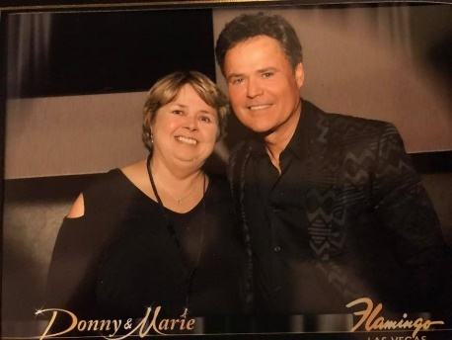
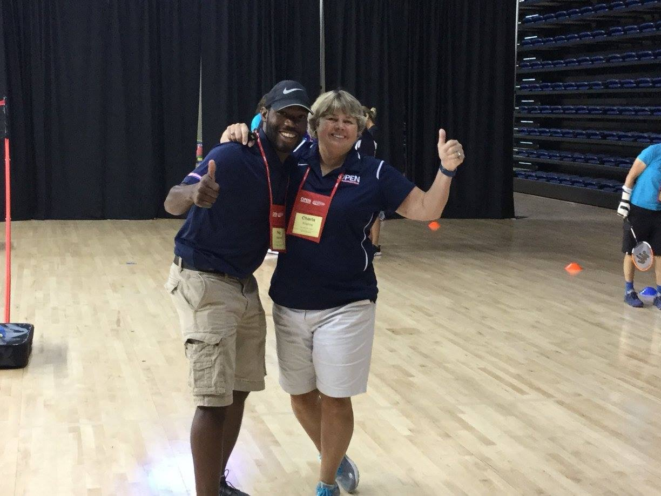
About Me….

Slide 3
What Is OPEN?

Slide 4
Academic Literacy

Slide 5
Registration Video

Slide 6
Instant Activities:
Dance Videos
Group Juggle
High Five Bank Account
First Things First
RPS Victory Lap
Around The World RPS
Robotics Lab
Toss 3
Sort Yourselves

Slide 7
RPS Relay

Slide 8
Virginia Standards of Learning
Standard 1 [10.a, b] Demonstrate skill attainment in one or more lifetime activities (a); Apply and demonstrate knowledge of how movement is created, directed, and stabilized in one or more lifetime activities (b).
Standard 1 [11/12.a,b,c,] Demonstrate mastery in all basic skills and movement patterns required for the selected activity and the ability to use the skills with consistency in the appropriate setting (a);
Standard 4 [9.a,e,g] Identify and demonstrate proper etiquette, respect for others, integrity, and teamwork while engaging in a variety of activities (a); Apply communication skills and strategies that promote positive team/group dynamics

Slide 9
Badminton Standards & GLOs
Standard 1. Demonstrates competency in a variety of motor skills and movement patterns.
H1.L1&2. Demonstrates competency and/or refines activity-specific movement skills in two or more lifetime activities (net/wall games) (L1).
Standard 2. Applies knowledge of concepts, principles, strategies, and tactics related to movement and performance.
H1.L1&2. Applies the terminology associated with exercise and participation in selected individual-performance activities, dance, net/wall games, target games, aquatics, and/or outdoor pursuits appropriately (L1).

Slide 10
Badminton Standards & GLOs
Volley Challenge
Peer Assessment
Decoder
Serving Competition
Racquet Handling
Racquet Square
Move and Clear
Royal Court/Fronton

Slide 11
Plug & Play Fitness
4-Corner Boogie
4 Corner Boogie Cards
Warrior Fitness
Pitch & Go Treasure
Fitness Uno
20 meter RPS Challenge

Slide 12
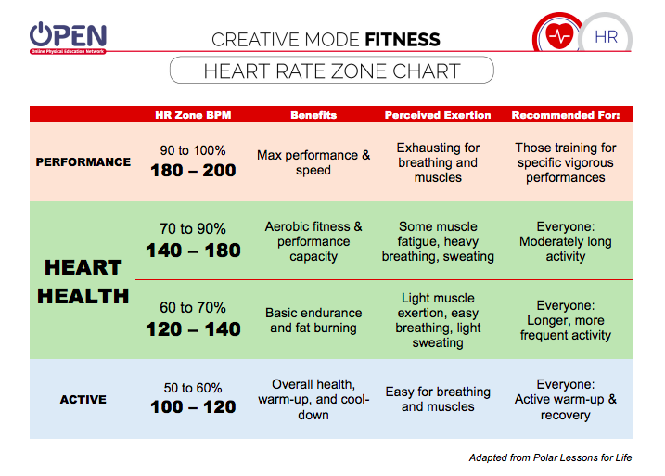
Creative Mode Fitness HS

Slide 13
Ultimate Frisbee
Frisbee/Volleyball
Ghosts In The Graveyard
Disc Tag
Hula Hut Frisbee
6 way Frisbee
Ultimate Football
Disc Games on http://charlaphysed.com/

Slide 14
Teambuilding Challenges/
Machine Shop
Aerobic Numbers
Aerobic Tic Tac Toe
Capture The Corner
Switch
Catch Game In Grids
Dancin’Train
Create A Dance: 4 dance moves to 8 count
Music: What Makes You Beautiful

Slide 15
Roundnet/Spikeball
Curriculum/Resources
Self /Partner Passing
Selfie-Spikes
Tossing Drills
Rally Time
Compass Draw Tournament

Slide 16
Selfie-Spikes
Object: Land your spikes inside the hoop.
Level 1- Toss to Partner
Self-Pass Spike into hoop
Level 2- Attempt to spike on the spot marker

Slide 17
National Standards HS
Selfie Spikes
Standard 1 [H1.L1-2] Demonstrates competency and/or refines activity-specific movement skills in two or more lifetime activities (outdoor pursuits, individual performance activities, aquatics, net/wall games, or target games) (L1); Refines activity-specific movement skills in one or more lifetime activities (outdoor pursuits, individual-performance activities, aquatics, net/wall games, or target games) (L2).
Standard 2 [H2.L1-2] Uses movement concepts and principles (e.g., force, motion, rotation) to analyze and improve performance of self and/or others in a selected skill (L1); Describes the speed/accuracy trade-off in throwing and striking skills (L2).
Standard 4 [H5.L1] Applies best practices for participating safely in physical activity, exercise, and dance (e.g., injury prevention, proper alignment, hydration, use of equipment, implementation of rules, sun protection) (L1).

Slide 18
Depth of Knowledge:Selfie Spikes
DOK 1: What would you include on a list describing the pros and cons of hitting a Spikeball® with speed?
DOK 1: What would you include on a list of reasons why it is important to hit a Spikeball® accurately?
DOK 2: How would you summarize the speed/accuracy trade-off related to Roundnet spikes?
DOK 3: How is speed related to accuracy when spiking?

Slide 19
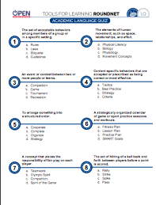
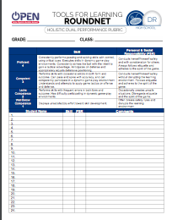
Assessments

Slide 20
OPEN 8
Awaken The Earth
Awaken The Earth Cards
Life of Water
Life of Wind
Life of Wind Cards

