Slide 1
Sport Education:
A Teaching Model That Never Grows Old!
Charla Tedder (Parker) Krahnke
National HS PE TOY 2013
Southern District 2013
NCAAHPERD-SM 2013
US Games Presenters Network
OPEN National Trainer

Slide 2
Sport Education Goal:
To become a more skilled, knowledgeable, and enthusiastic sportsperson.
Student Outcomes
Physical activity and Physical Literacy
Success in skill performance
Success in game play – tactics
Responsibility
Notes:
The basic goal of Sport Education is to make the sport experiences in physical education more real for ALL students by developing competent, literate, and enthusiastic players of sport.
Competent: have sufficient skills to participate in games satisfactorily, and understand and use strategies appropriate to the game
Literate: understand and value the rules, rituals and traditions of sport, and distinguish between good and bad sport practices, and more able to participate and be a more knowledgeable fan or spectator.
Enthusiastic: participate and help maintain a positive and healthy sports culture within class, the school and the community, and become involved in sport and promoting it within the community.

Slide 3
What Does it Mean to Be Skilled?
You…
have sufficient skills to participate in games satisfactorily, and
understand and can use strategies appropriate to the game.

Slide 4
What Does it Mean to Be More Knowledgeable?
You…
understand and value the rules, rituals, history, and traditions of sports;
can tell the difference between good and bad sport practices; and
can explain to others what is going on during a match(e.g. Team strategy and tactical moves).

Slide 5
What is an enthusiastic sportsperson?
You…
participate and help maintain a positive and healthy sports culture during class, at school, and in the community.
become involved in sport and promote it within the community.

Slide 6
Sport Education
An instructional model for implementation in elementary, middle and secondary school programs with varying levels of adaptation.
How is it different than sport?
  Students are responsible for their own learning.
  All students participate.
  In addition to learning how to play the game, you will learn to perform other nonplaying roles.
Notes:
Sport Education is simply a curricular model for implementation in elementary, middle and secondary school programs.
Grade Level Appropriate? Adaptation
K-3 ?
Grades 4-5 YES More teacher direction, less student roles
Middle YES Modification of rules
High YES None

Slide 7
Sport Education is NOT the same as sport….
It requires equity of participation of opportunity by having:
  Small sided teams
  No elimination tournaments
  Emphasis on fair play, effort as valuable an outcome as result
  Celebration of success – record keeping and culminating event.
Teaches students different roles in sport
  coach, captain, referee, statistician, etc.
Notes:
Sport Education is NOT the same as sport.
It requires equity of participation of opportunity by having:
small sided teams
no elimination tournaments
emphasis on fair play and effort is as valuable an outcome as a result (win/loss)
celebration of success (record keeping, culminating event)
Also, it teaches students different roles in sport (coach, captain, referee, statistician, etc.)

Slide 8
Changing role of teacher
New planning requirements- more pre-class planning to facilitate student coaching role
Designing team practice and competition schedules
Moving off center stage – students take lead
Helping students assume responsibility- guide players and coaches to work together
Notes:
Due to the design of sport education, there is a changing role of the teacher who utilizes this approach:
The teacher takes on new planning requirements in that the majority of the planning occurs before class to facilitate student coaching role.
The teachers move off center stage, and the students take the lead. Teachers that utilize the sport education model give up some of their “power”.
A large part of times is spent on helping students assume responsibility…teachers help guide “players” and students to work together.

Slide 9
Changing role of student
Active participation
Taking responsibility for:
  Their own behavior
  Running the class
  Fulfilling their role/duties
Leadership
Cooperation
Accepting and supporting others
Notes:
Additionally, the role of the student changes from traditional, multi-activity curricula as well.
Students must engage actively in class.
They also must take responsibility for two things: their own behavior as well as responsibility for running the class.
Additionally, students exhibit leadership, cooperation and accept support from others and provide support to their teammates.

Slide 10
Features of Sport Education:
Seasons (>15 secondary, 10-12 elementary)
More time for strategic gameplay
Team Affiliation: roles, posters
Formal Competition: Team round robin
Culminating Event: Season championship
Involve all participants
Record Keeping: Shot charts, stats
Festivity: Awards

Slide 11
Phase 1: Team selection
Who will select teams? Teacher? Coach?
How will they be chosen? Captain made, Draft, Team Shake?
What size teams? How many teams?
Teams made by skill level, interest, attitude, attendance and gender.
What effect will absences have?
What roles will be used?
Notes:
With regard to team selection, it is important to consider who will select the teams, how will the teams be chosen, what size teams do you want, how many teams, what roles will be used (you want to be sure each student on the team has a role), and how will absences effect team size.
An example I have used in the past is:

Slide 12
Team Roles
Coach
Captain
Manager
Exercise specialist
Publicist
Commentator
Referee
Motivator
Sports Council
Safety Manager,
ball retriever (volleyball)
Down Marker (flag football)
Place Judge (track and field), Videographer, Trainer, First Aid, Timer
Notes:
There are a variety of roles that students can play within their teams. I will name a few, but you can be as creative as you want and design the roles around the needs for the particular sport you are teaching, the needs of the class based on personalities, etc….
Coach
Captain
Manager
Fitness specialist
Publicist
Commentator
Referee
You may also have specialist roles such as:
ball retriever (volleyball)
Down Marker (flag football)
Place Judge (track and field)

Slide 13
Phase 2: Teacher-directed
How is equipment, space going to be organized?
As students enter the gym, they should be provided with procedures for the day. (Folders, notebooks…)
Gradually introduce student responsibility
  Captains and fitness specialist taking warm-up
Teacher leads students through whole class instruction of critical skills
  Walk-through of how to communicate when coaching
Notes:
Phase 2 is the teacher directed phase. There are some managerial considerations in this phase that are very important to the layout of the particular unit such as how is the equipment and space going to be organized to create practice areas for each team.
In the teacher-directed phase, you are gradually introducing student responsibility. An example is that after a day or two, you may have captains taking over warm-up
In this phase, the teacher leads students through whole class instruction of critical skills
Walk-through of how to communicate when coaching

Slide 14
Phase 3: Pre-season phase
Captain led warm-up
Student coach-led practice
Small-sided Modified games
  Training for referees
  Training for statisticians
Notes:
The pre-season phase is typically 4-5 lessons.
Examples of what is occurring in this phase include:
captains lead warm ups
Student coaches lead practice
Small-sided modified games which the referees call the games.
The Pre-Season phase is a great time to reinforce team affiliation:
examples include: Team uniforms, team posters, team philosophy, log team offensive and defensive plays, etc.

Slide 15
Phase 4: Formal competition
Captain and/or coach led warm-up
Coach-led “tactical” session on game-play strategy
Formal scrimmage
  How will it be scored?
  Assessment of individual/team performance
Important Considerations When Designing Competition Formats:
  Students get equal playing time and learn to play different positions
  Emphasis is on TEAM and team performance
Notes:
Phase 4/Formal Competition typically lasts 3-4 days:
An overview of this phase:
captain and/or coach led warm ups
coach-led “tactical” session on game play strategy
Formal scrimmage
how will it be scored
Assessment of individual/team performance
Important Considerations When Designing Competition Formats:
Students get equal playing time and learn to play different positions
Emphasis is on TEAM and team performance

Slide 16
Phase 5: Culminating Event
Awards and recognition of team and season success.
Choice of type of celebration.
Notes:
Phase 5 is the final day of the unit and includes awards and recognition of the team and season success.

Slide 17
Sport Education Conclusions
Students participate in the way they choose.
Students love this curricular approach, therefore more participation.
Get to know fellow classmates.
Knowledge and skills of a sport improve.
Attendance improves. Students do not want to let their team down by being absent. Look forward to daily activities.

Slide 18
Elementary Sport Education
Same team all year/Teacher picked/Home base
Teamshake app or Teammates
Three teams 8-10 on a team
Small-sided games for all activities
No more than 4 playing from team
Less time for games, less duties
30 minute classes 10-14 lessons
45 minute classes 8-12 lessons
Teach routines for class, Start with fitness

Slide 19
Elementary Basketball
1 vs 1 Dribbling, drive for basket, change direction,
Drive for basket and pull up for shot, add defender with defensive stance
2 vs 2
3 vs 3

Slide 20
Elementary Point Examples
1 point - begin warm-up within 3 minutes of arriving
1 point - return equipment
1 point – ready to begin activity
1 point – after match line up to shake hands

Slide 21
Fitness Season
Divided by weight lifted on incline press, squats and clean, Bench press
Weekly challenges: With or without weights
Teacher designed workouts then student designed
Early season focus on safety, technique and more competitive as season progresses.
Points include technique

Slide 22
Modifying Games/Activities
Purpose: put the needs of young people first.
Make Scoring easier.
Slow the movement of the ball
Increase opportunities to practice techniques and tactics.
Sequence games to enable the learning of tactics.
Examples: lower goals, larger equipment, shorter implements, increase time of possession, no steals,

Slide 23

Team Poster

Slide 24
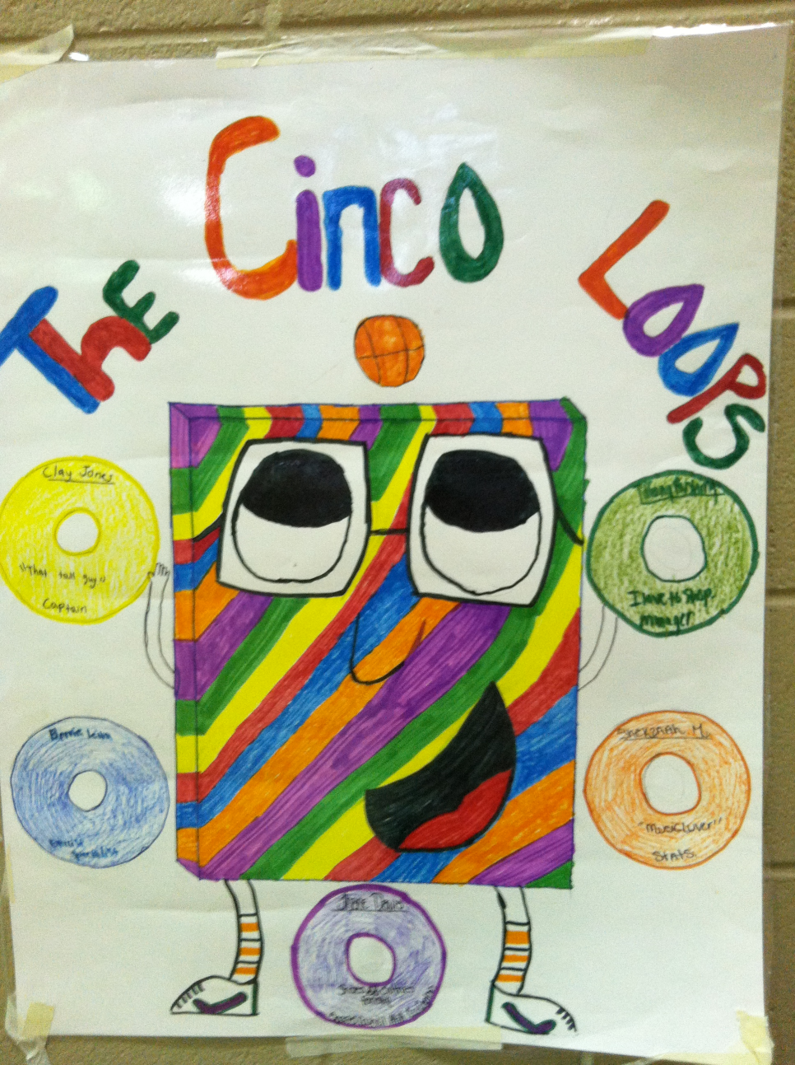
Team Poster

Slide 25
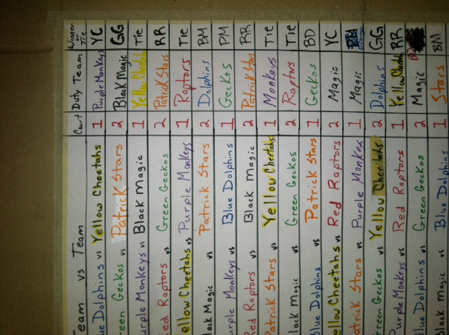
Round Robin Results Poster

Slide 26
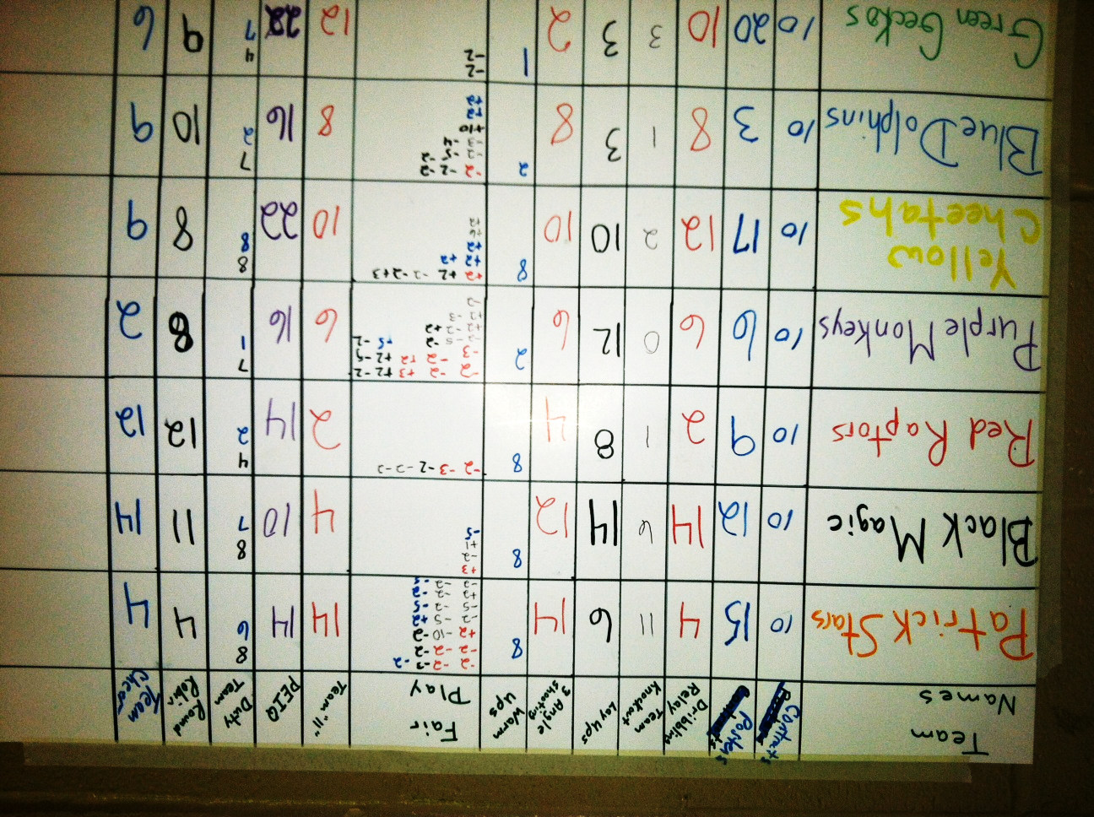
Points Poster

Slide 27
Excellence in
Daily Duty Team Performance
Award
Presented to
_____________________
for exhibiting great organization and teamwork
during today’s class
Signature League Commissioner
Date

Slide 28
Officiating Excellence Award
Presented to
________________________________
for calling a great game.
Way to Go!!
Signature League Commissioner
Date

Slide 29
How do I implement a new model in my program?
1. Start Small
2. Keep a Goal in Mind
3. Go with your best class… or your worst
4. Expect Resistance
5. Go with Your Strengths
6. Emphasize 2 or 3 Features at the beginning
7. Find a Colleague who is Interested

Slide 30
Resources
PE.Metrics Assessing National Standards 1-6 in Secondary School (2011)National Association for Sport and Physical Education, Reston, Va.
Pipeline Teaching Instructional Models in Standards-Based Physical Education. (2011) NASPE VA: Author
Assessment Strategies Secondary Physical Education (2011) 2nd edition, NASPE, Reston, Va
Lund, Jacalyn Lea,PhD, Kirk, May Fortman, PhD (2010) Performance-Based Assessment for Middle and High School PE, 2nd edition, Champaign, IL: Human Kinetics
Siedentop, D. (1994). Sport education: quality P.E. through positive sport experiences. Champaign, IL: Human Kinetics

Slide 31
Resources (cont.)
Siedentop, dl, Hastie, P. A., & van der Mars, h. (2004) Complete guide to sport education. Champaign, IL: Human Kinetics.
Siedentop, D. (1998) What is sport education and how does it work? Journal of Physical Education, Recreation, and Dance, 69, 18-20.
Townsend, J.Scott, Mohr, Derek J., Rairigh,Richard M.& Bulger, Sean M. (2003) Assessing Student Outcomes in Sport Education: A Pedagogocal Approach. National Association for Sport and Physical Education
Bulger, Sean M., Mohr, Derek J., Rairigh,Richard M.& Townsend, J.Scott (2007) Sport Education Seasons, Champaign, Il: Human Kinetics.
Dr. Kimberly Bush NC State University
Jessica Hook Bugg Elementary

Slide 32
Charla Tedder (Parker) Krahnke
Ocean Isle Beach, NC
charlaphysed@gmail.com
Charlaphysed.weebly.com
Twitter - @ncpe4life
919-270-9633

